Slide 1
Queues
Materials are adapted from “Data Structures: A Pseudocode Approach with C,” 2nd ed., by Richard F. Gilberg & Behrouz A. Forouzan

Slide 2
Queue
A queue is a linear list in which data can only be inserted at one end, called rear, and deleted from the other end, called front.
The data are processed through the queue in the order in which they are received
Queues are known as the first in–first out (FIFO).

Slide 3
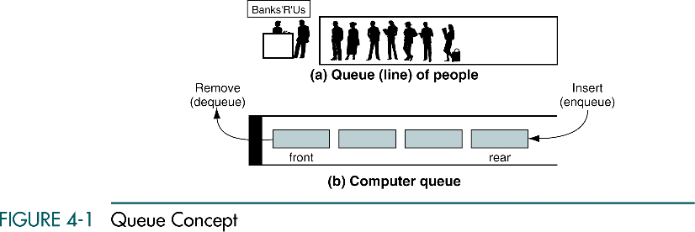
Queue

Slide 4
Queue Operations
Four basic queue operations
Enqueue : inserts data at the rear
Dequeue : deletes data from the front
Queue front : retrieves data from the front
Queue rear : retrieves data from the rear

Slide 5
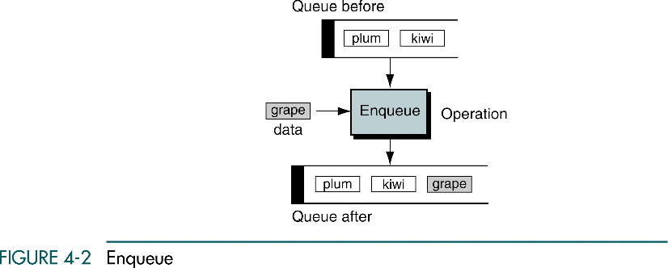
Enqueue
Enqueue is the queue insert operation
After enqueue, the new element becomes the rear
The only potential problem
Is running out of room for the data
If there is not enough room, overflow state

Slide 6
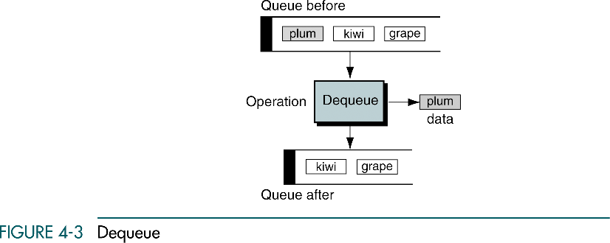
Dequeue
Dequeue is the queue delete operation
The data at the front of the queue are returned to the user and removed from the queue
If there are no data in the queue when a dequeue is attempt, underflow state

Slide 7
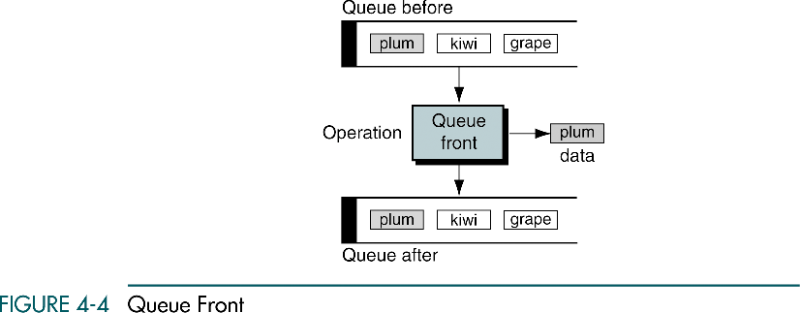
Queue front
Queue front retrieves data at the front of the queue
Returns the data at the front of the queue without changing the contents of the queue

Slide 8
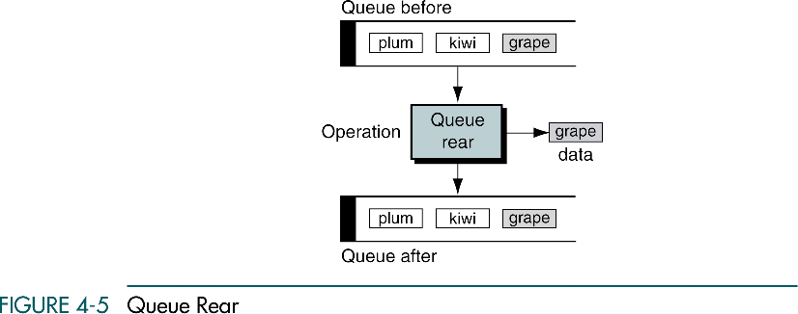
Queue rear
Queue rear retrieves data at the rear of the queue

Slide 9
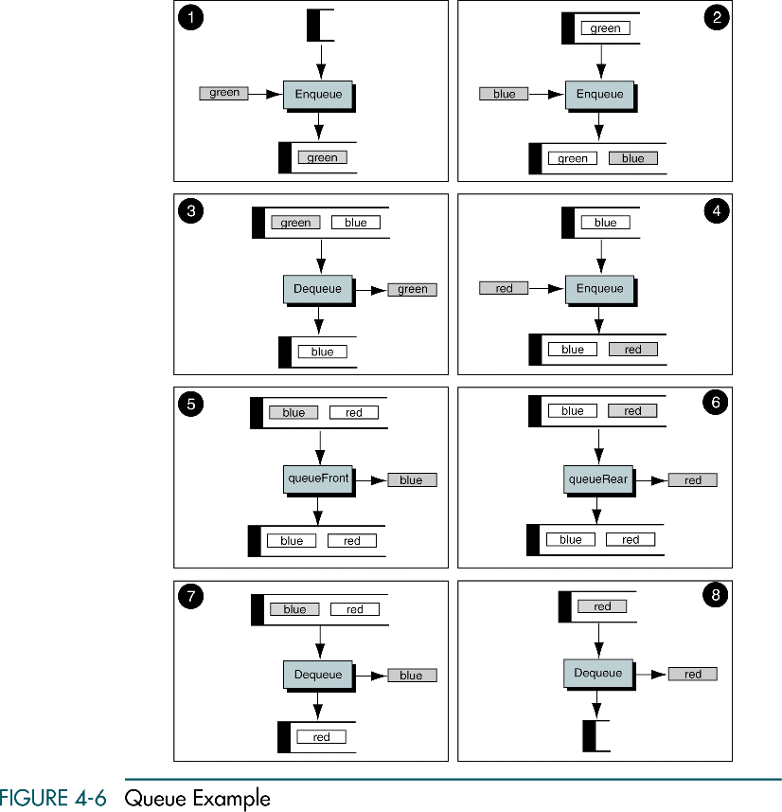

Slide 10
(Continued)

Slide 11
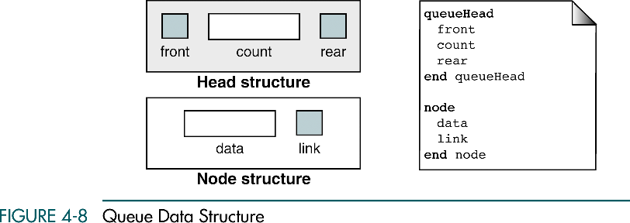
Queue Linked List Design
Data structure
Head
Metadata
A pointer to the front and rear of the queue
Data node
Data
A link pointer to the next node

Slide 12
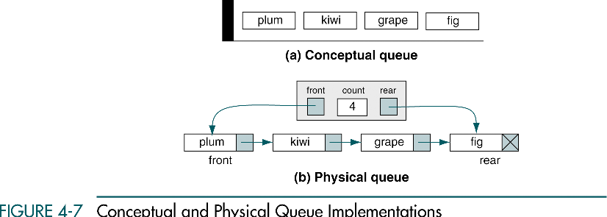
Queue Linked List Design

Slide 13
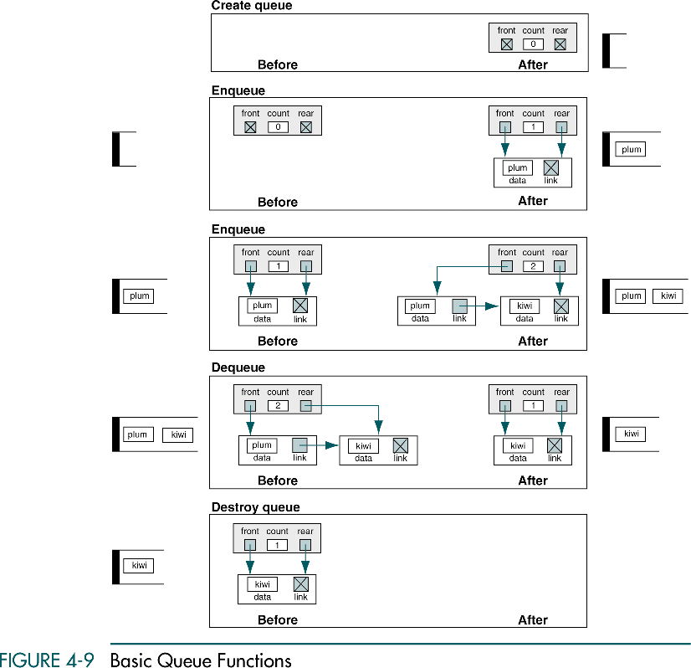

Slide 14
(Continued)

Slide 15
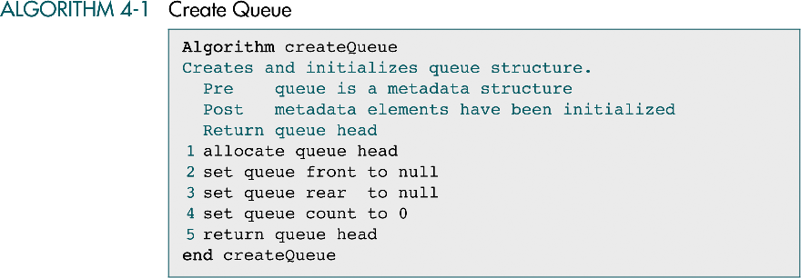
Create queue

Slide 16
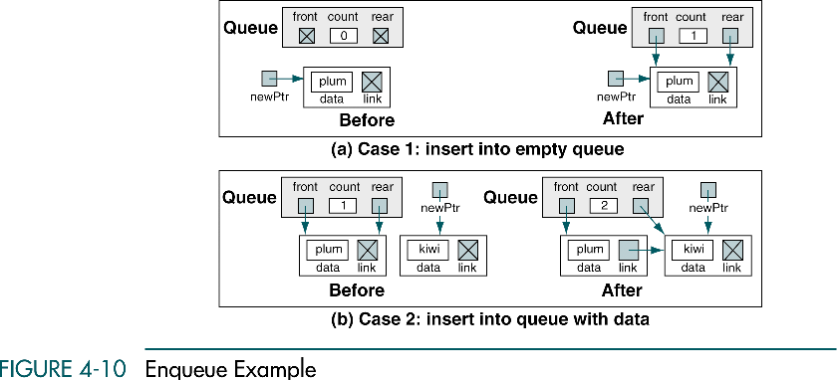
Enqueue

Slide 17
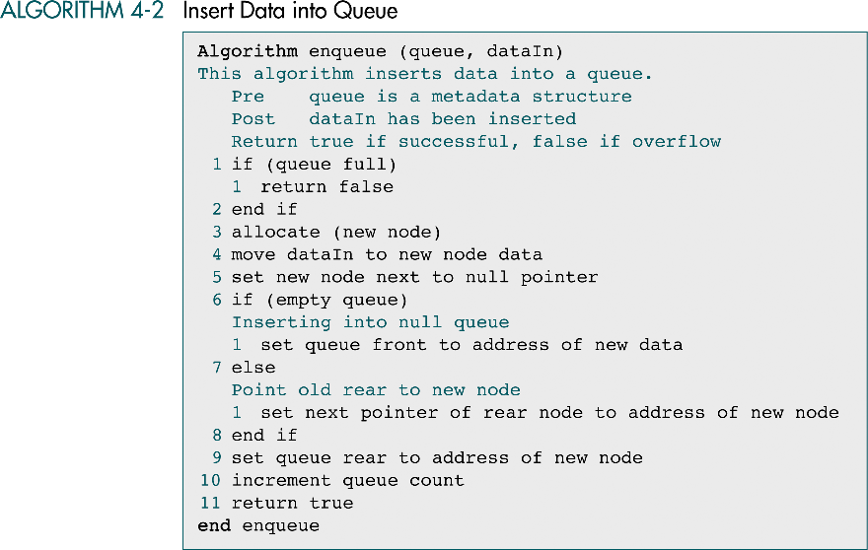

Slide 18
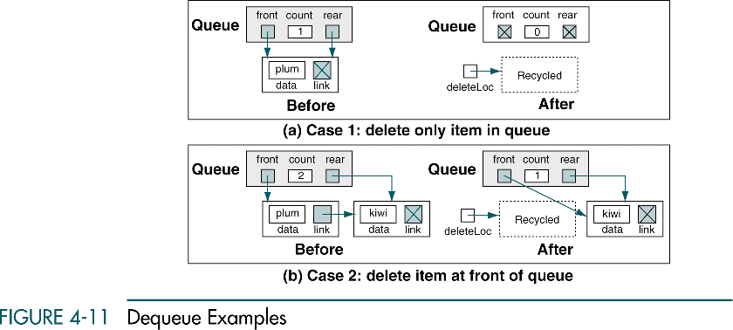
Dequeue

Slide 19
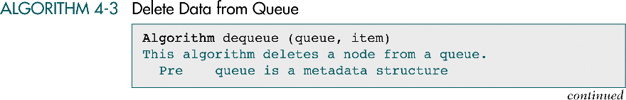
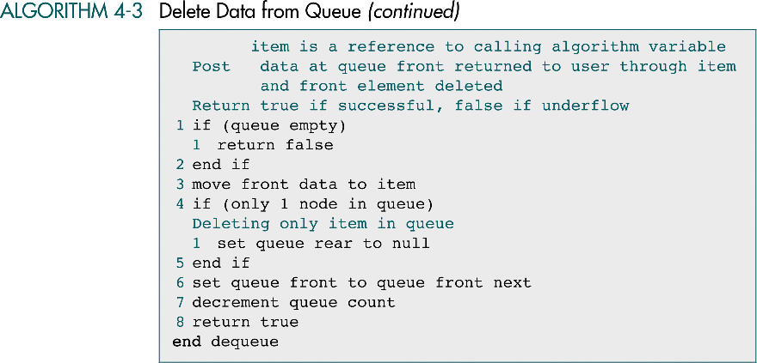

Slide 20
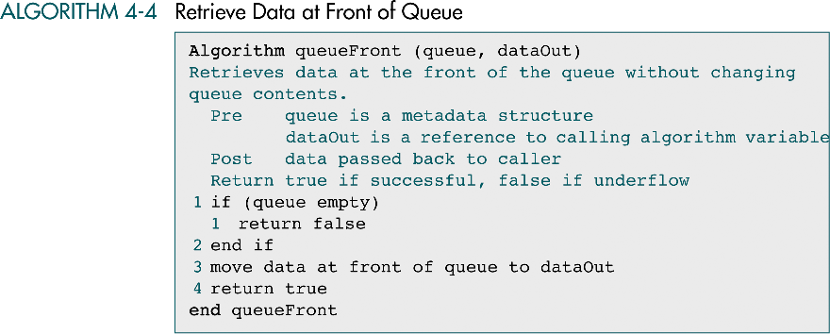
Queue front / rear

Slide 21
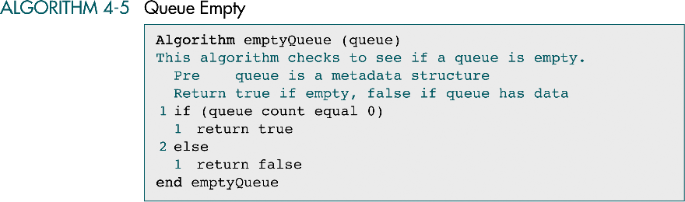
Queue empty

Slide 22
Full queue

Slide 23
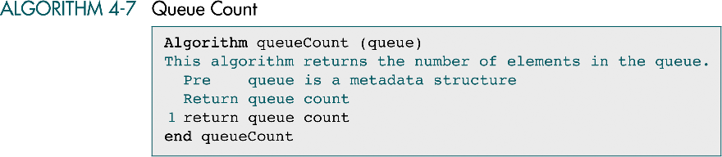
Queue count

Slide 24
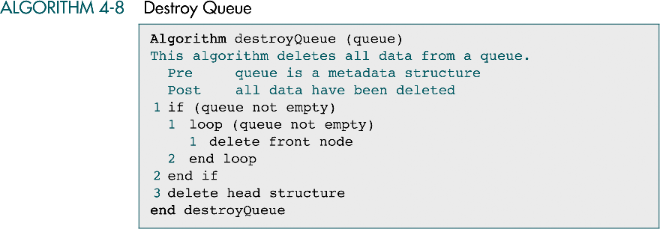
Destroy queue

Slide 25
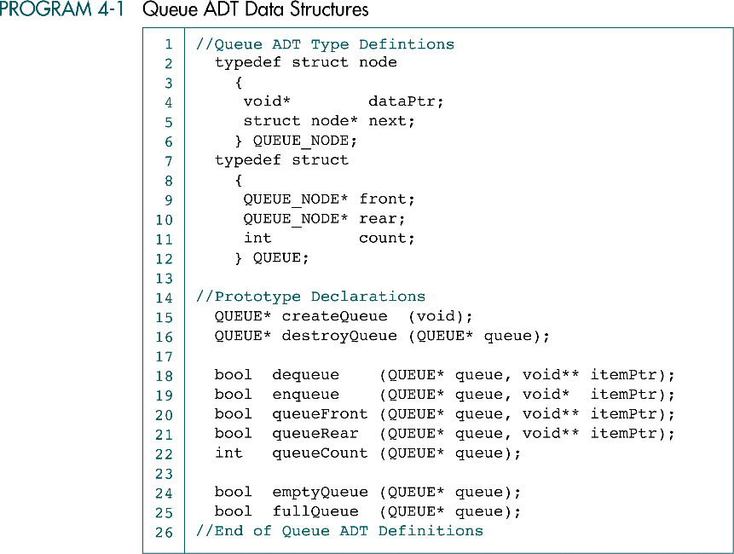
Queue ADT

Slide 26
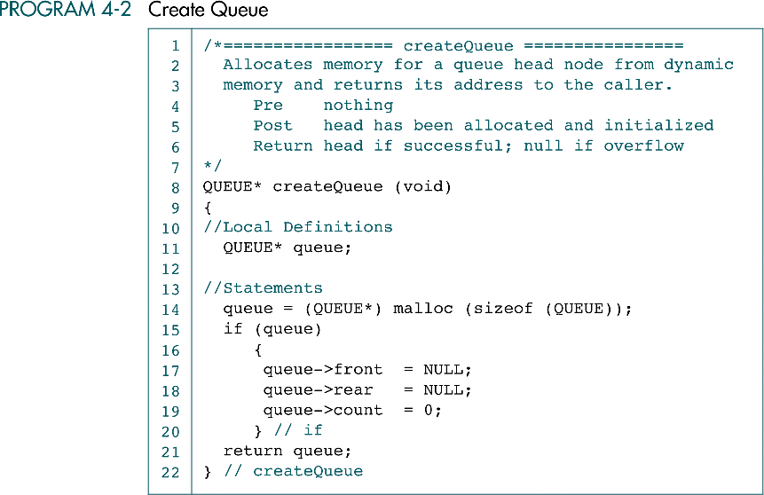

Slide 27
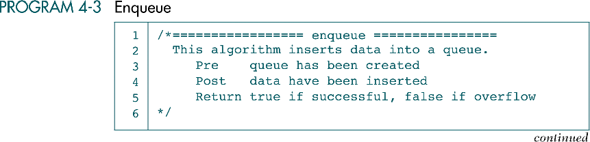
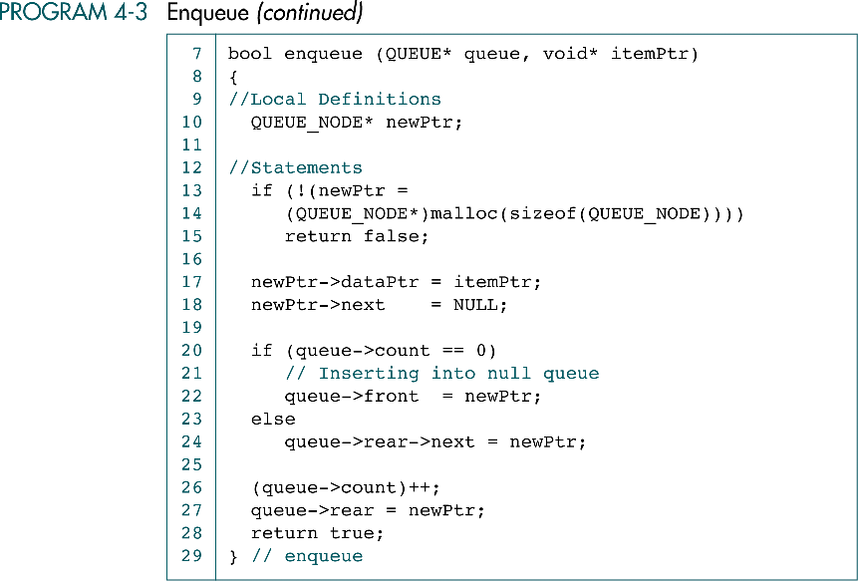

Slide 28
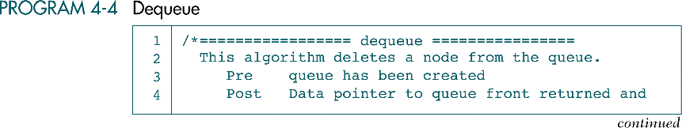
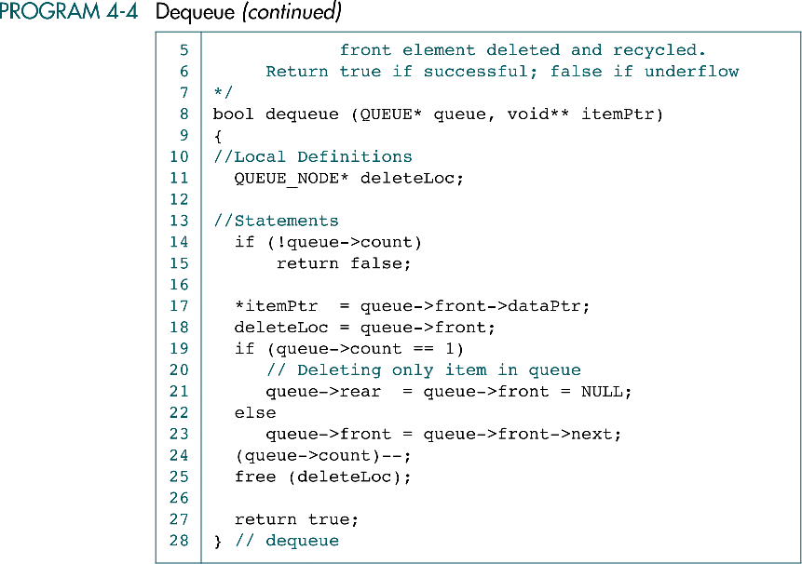

Slide 29
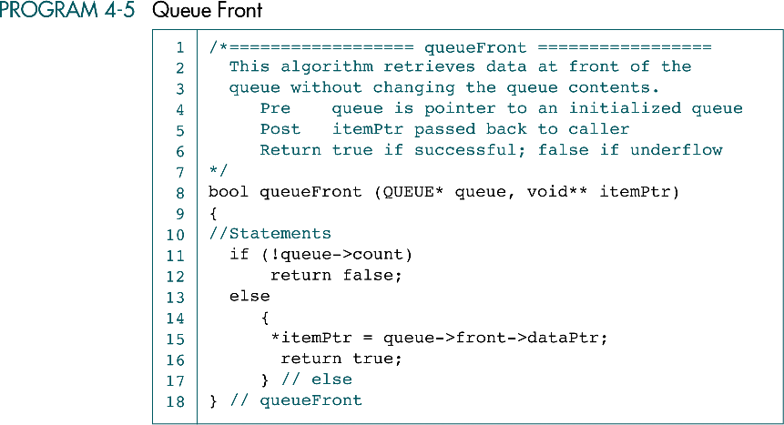

Slide 30
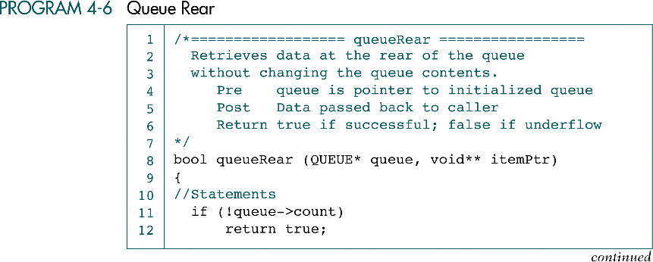
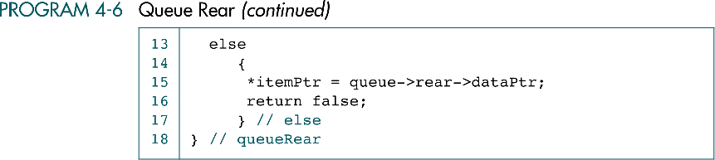

Slide 31
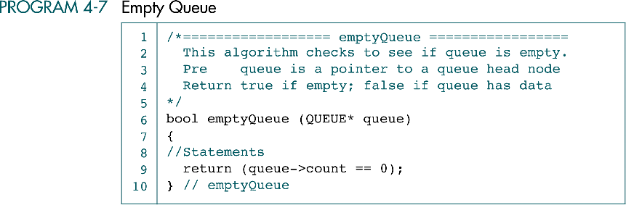

Slide 32
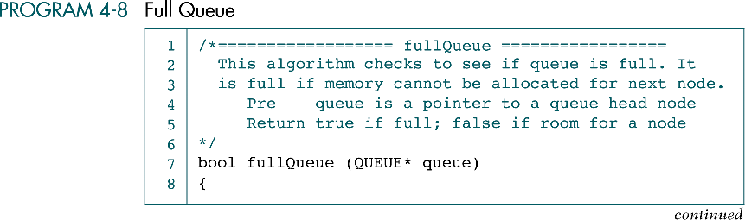
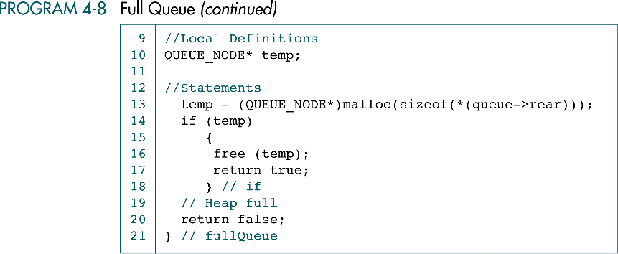
false;
true;

Slide 33
